Slide 1
Director’s Report
Unidata Users Committee Meeting
26 March 2015
Boulder, CO
Mohan Ramamurthy
Unidata Program Center
UCAR Community Programs

Slide 2
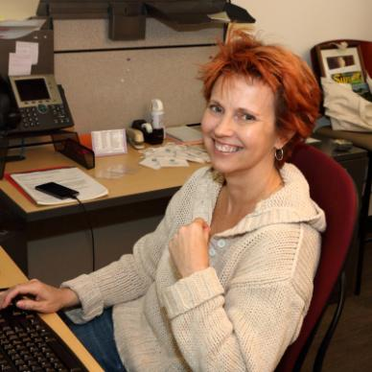
New Staff
Unidata is pleased to welcome Inken Purvis, who joined us on 2 March 2015.
Inken will be UPC’s new Travel Coordinator, among other administrative duties.
She has extensive administrative and marketing experience in the financial, publishing, and pharmaceutical industries.

Slide 3
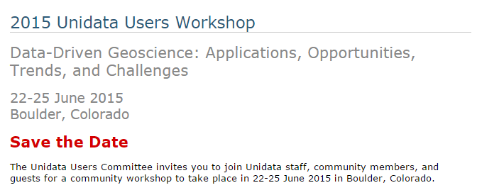
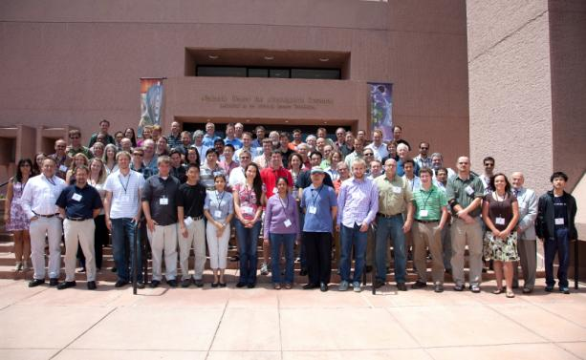
Unidata Users Workshop Proposal
The workshop proposal was submitted on 3 February 2015.
      Data-Driven Geoscience: Applications, Opportunities, Trends and Challenges
The proposal is currently being reviewed internally at NSF.

Slide 4
Community Services
Actively engaged in the UCAR Education Working Group and UCAR-Connect to explore novel techniques and applications for the educational community.
Site visits were made at the Metropolitan State University of Denver, Colorado State University, and University of Northern Colorado. This is a pilot program and will be expanded as resources permit.
Working closely with NCAR scientists and the CUAHSI on a National Flood Interoperability Experiment. This opportunity is created through the opening of a new National Water Center on the Tuscaloosa campus of the University of Alabama, which is to become the national center for river flow forecasting. The intent is to establish a research partnership with the academic community that will sustain innovation into the future.

Slide 5
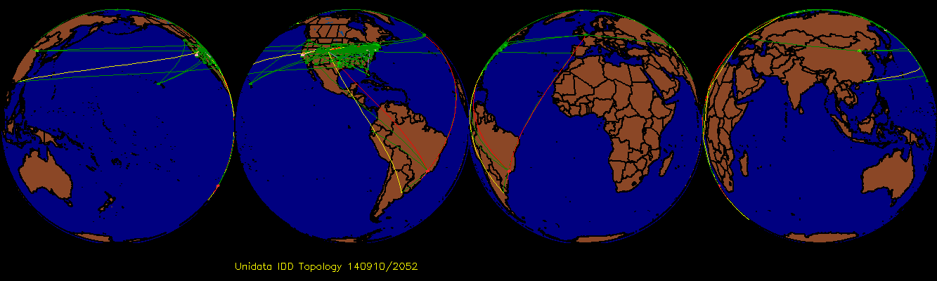
Real-time Data Flows
The UPC has been evaluating ingest and relay of the 0.25 degree GFS data that became operational in NCEP on January 14, 2015.
Testing has shown that peak CONDUIT data volumes would increase from about 8 GB/hour to about 21 GB/hour if all forecast hours for the 0.25 degree GFS were added to the current set of products being delivered.
A working group composed of User Committee members and Unidata staff prepared and distributed a questionnaire that is primarily aimed gauging the community's interest in getting the 0.25 degree GFS data added to CONDUIT.

Slide 6
NOAAPort SBN Upgrade
The NOAAPort SBN, which transitioned from DVB-S to DVB-S2 in April/May 2011, was upgraded again in August 2014.
For some period, we and other partners were experiencing high number of missed frames due to poor signal quality.
The firmware for the Novra S300N receivers are being updated to fix the problem.
The new broadcast, among other new products, will include HRRR model output.
Unidata's NOAAPort ingest package is bundled with current versions of the LDM. The current LDM release is v6.12.6, and v6.12.7 is being readied for release
As previously presented, Raytheon bundles a version of LDM-6 with AWIPS II and is using it for data ingest at many NOAA offices.

Slide 7
THREDDS
Version 4.5.5 of the TDS (beta) and netCDF-Java (stable) was released in early March 2015.
In addition to fixing several bugs, the update includes
  Implementation of OPeNDAP 4.0 protocol (beta)
  Improvements to writing of CF 1.6 Discrete Sample Geometry files, handling of GRIB files and collections of point, station, and sounding data
Implementation of OPeNDAP 4.0 protocol (beta)
WaterML as output format from NCSS point service
An instance of the TDS, a clone of http://thredds.ucar.edu, is up and running in the cloud.
Collaborations include working with NCAR/CISL, US IOOS, Earth System Grid Federation, ECMWF, and UK Met Office.

Slide 8
Cloud Efforts
Unidata’s cloud efforts are progressing well and they fall into three categories:
Generating IDD products and other experimentation
  We are operating mid-sized instances in both the Amazon EC2 and Microsoft Azure clouds for the purpose of generating image products for the IDD FNEXRAD (NEXRAD Level III national composites) and UNIWISC (GOES-East/West image sectors) data streams.
Enabling AWIPS II EDEX Data Servers
  We are testing small footprint EDEX servers (no NEXRAD Level 2 or 3 or high-resolution CONDUIT models) on both Microsoft Azure and Amazon EC2 cloud server environments.
  An EC2 instance was created cooperatively by Unidata and Embry Riddle Aeronautical University (ERAU) as part of ERAU's equipment grant award.
Running the IDV on Microsoft Azure and streaming the resulting displays to connected devices
  Using the Azure Web API, we are able to dynamically allocate and provision VMs for use with hosting the IDV.
We are also taking initial steps for creating a “Motherlode-lite” type data services on Amazon EC2 and toward creating a “Unidata-in-a-box” virtual image of Unidata software.

Slide 9
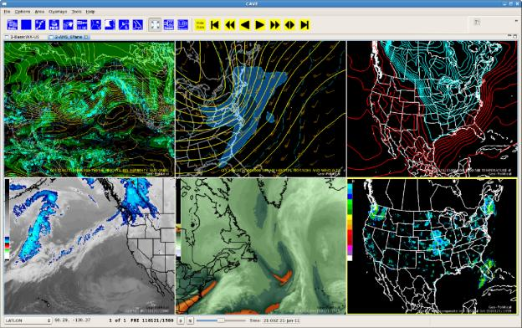
AWIPS II
Unidata is making available AWIPS II 14.2.1 release to its users.
Raytheon has released 14.4.1, but a number of changes to the distribution and software build processes have been made. This has posed numerous challenges for Unidata.
Meanwhile, progress is being made on a number of fronts with the previous build, including the addition of new grids and satellite products, creation of a localization RPM, and a major revamping of AWIPS II training,
We are continued our work in deploying AWIPS II EDEX servers in the cloud.
Working with Embry Riddle University in their installation on Amazon EC2.
NOAA released the AWIPS II recompetition RFP in late January 2015.
UCAR, including Unidata, have been approached by potential bidders on possible partnerships. Discussions are in early stages.

Slide 10
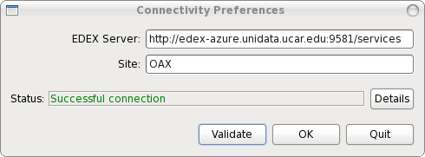
AWIPS II in the Cloud: Microsoft Azure
The Azure instance served data to AWIPS II beta users in 44 organizations, including 13 universities.
Unfortunately, the Microsoft Research grant that provided that service ended in February, so we had to terminate the service.
Unidata is working on a follow-on proposal to Microsoft.

Slide 11
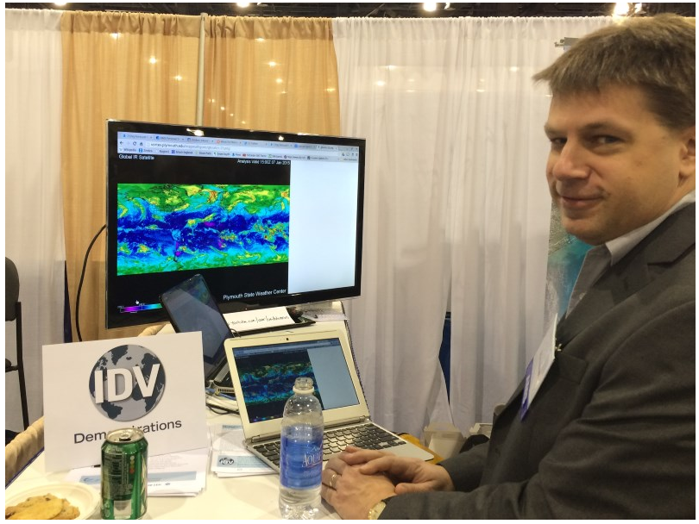
Integrated Data Viewer
IDV 5.1 was released on 11 March 2015.
System Changes
Incorporates netCDF-Java 4.5.5
The Windows installation is now signed with a UCAR published security certificate.
Several improvements to OS X version
RAMADDA plugin enhanced
Display Changes
IDV can now apply time matching to CSV point data files
Data Changes
IDV now supports point data from AMRC
Now supports CFRadial netCDF radar data – work done in collaboration with NCAR/EOL
Brendan Hoch from Plymouth State University showing his own IDV graphics in the Unidata booth.

Slide 12
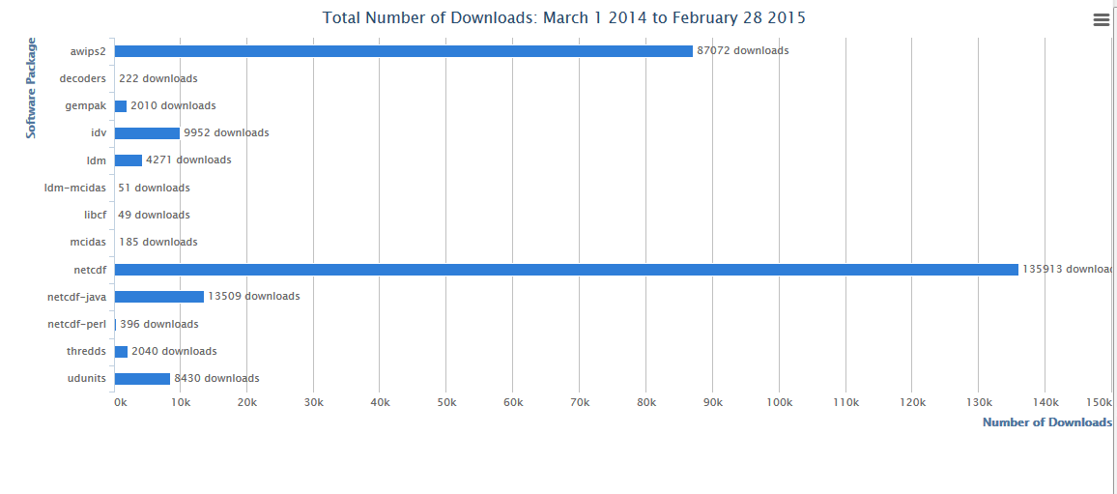
Software Downloads
Notice the large number of downloads for AWIPS 2.
.edu: 14,713; .com: 14,766; .net: 31,258; .gov: 458

Slide 13


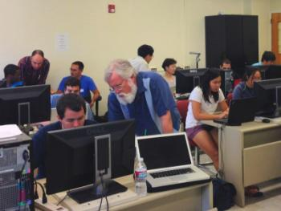
Unidata Regional Workshops
The University of South Florida and Florida Institute of Technology will host a Unidata Regional Workshop on April 10-12, 2015.
Several Unidata staff will be in attendance.
The main focus of the workshop will be the use of the IDV-RAMADDA to analyze and publish data from a variety of geoscience fields.
In addition, Unidata will conduct a training workshop on the use of the IDV, McIDAS-V (for Hydra) and RAMADDA in San Jose, Costa Rica in May, 2015.

Slide 14

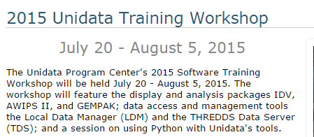
Unidata Training Workshops
The 2014 Unidata Software Training Workshop was held October 21 - November 6, 2014.
There were a total of 48 attendees.
Topics: Python, THREDDS, GEMPAK, AWIPS II, LDM, and IDV-RAMADDA

Slide 15
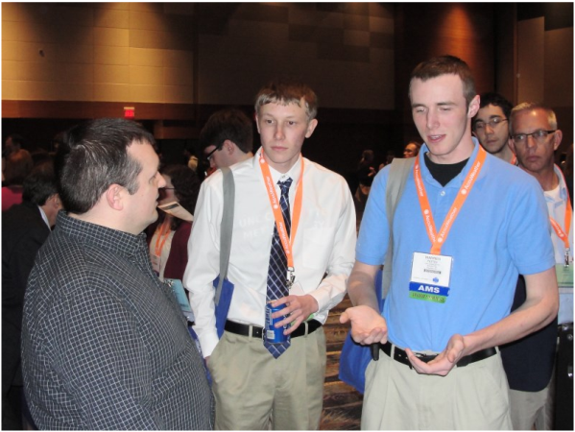
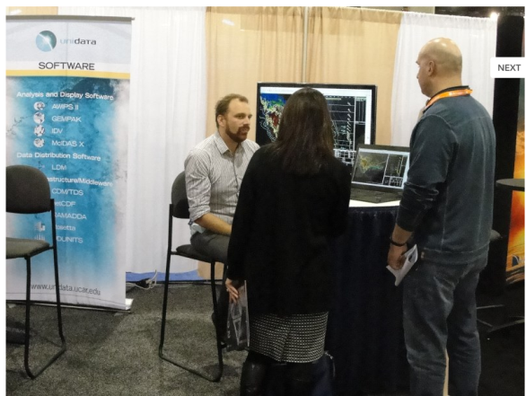
2015 AMS Annual Meeting
Unidata staff attended the AMS Annual meeting, held in January 2015 in Phoenix, AZ.
As in recent years, Unidata set up a table at the Career Fair, which attracted many students. This has become an important venue for recruiting Summer Interns.
We also had a booth in the Exhibit Hall.
There was a great deal of interest in AWIPS II as it continues to gain traction in academic, research, and commercial organizations.
As always, the IDV was a big draw.

Slide 16
2015 Community Equipment Awards
Again, special consideration was given to proposals that focused on a) AWIPS II installation; b) Cloud computing activities.
The RFP was sent out on 2 December 2014 with a 6 March submission deadline.
We received 9 worthy proposals. We also had a request from Embry Riddle for additional funds, as funds awarded last year were insufficient to cover the monthly fees from Amazon.
Once again, there is considerable interest in deploying AWIPS II, and there is some interest in deploying cloud-based data services.

Slide 17
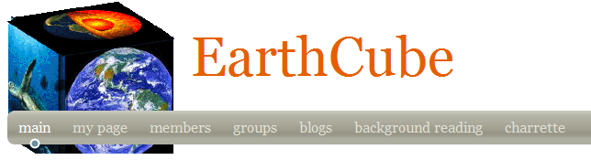
Unidata is continuing to be actively involved in EarthCube in a number of ways, including working on EC-funded projects, serving on or chairing committees, attending meetings and workshops, and participating in discussions on EarthCube’s future.
Unidata has recently led the submission of an EarthCube Building Block proposal, in response to EarthCube Integrative Activities solicitation.
  Advancing netCDF-CF for the Geoscience Community to support additional data types in netCDF-CF and broadening the range of GEO domains whose data can be represented.
  Funded partners include: UC Irvine, UT-Austin, U Wisconsin, U Washington, HDF Group, and NCAR/EOL.

Slide 18
ACADIS
The period of performance for the ACADIS project is coming to an end in January 2016.
NSF is competing the provision of data services for projects funded by the NS Arctic section. The UCAR ACADIS team is working to submit a proposal.
In the final year, the project will be in a wrap-up mode, focused on data collection and migration of the data and metadata database to a cloud environment, and the completion of the ongoing tasks.
Rosetta integration and documentation continues to be Unidata’s main role in the final year of ACADIS.

Slide 19
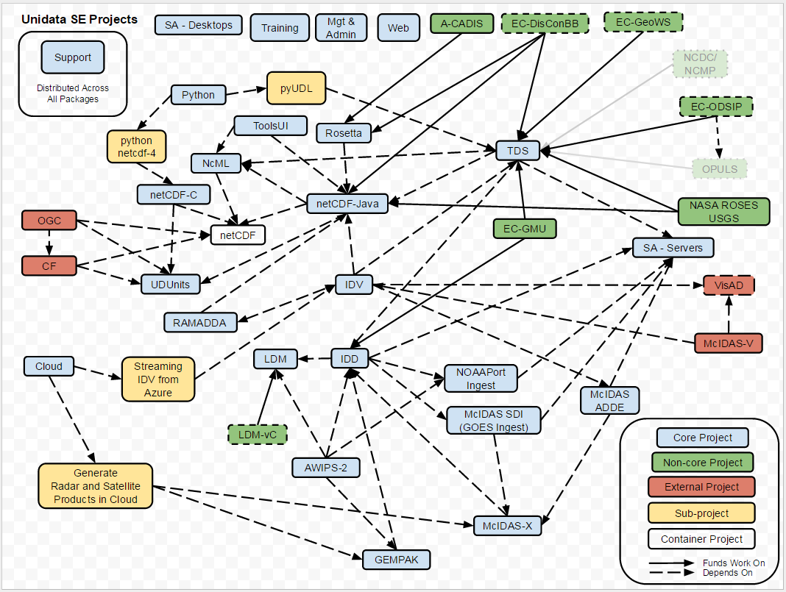

Slide 20
State of the Program: A Snapshot
Community relations : Green
Data flows : Green
Software development : Yellow
Support : Green
Collaborations & Outreach : Green
Staffing : Yellow
Finances : Yellow*
* Several non-core projects are ending this fall, which is likely to put pressure on the Unidata budget.
Unidata is funded primarily by the National Science Foundation (Grant NSF-1344155).

